Slide 1
Constructing Test Oracle for Web Applications with Active Learning Techniques
Advisor: Prof. Farn Wang
Student: Ting-Fen Wu
Department of Electrical Engineering, National Taiwan University, Taipei 106, Taiwan (R.O.C.)
Notes:
各位口試委員，各位同學大家好

Slide 2
Outline
Introduction
Methodology
Test Oracle Learning System
Trace Collector
Learner
Experiment Results
Conclusion

Slide 3
Outline
Introduction
Methodology
Test Oracle Learning System
Trace Collector
Learner
Experiment Results
Conclusion

Slide 4








Introduction - Background
Web Applications
Advantages
Wide range of uses
No installations
Universal access
Software Migration
Cloud services
Notes:
網頁程式漸漸充斥在我們的生活中，人們可以透過網頁social,查資料,娛樂,購物
Google 雲端office ->微軟
網頁程式的數量和複雜程度都快速成長，但是很多都沒有經過充分的測試

Slide 5


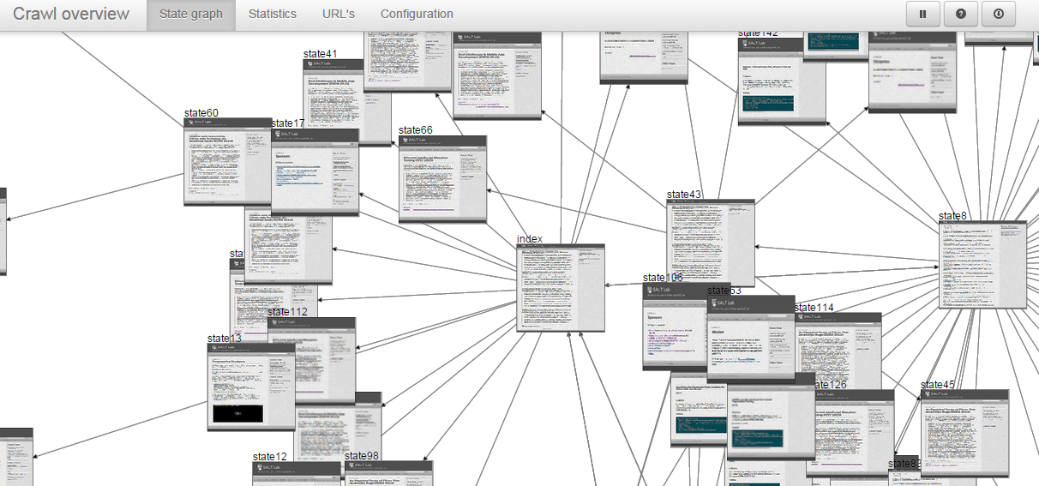
Introduction - Background
Web Testing
Test Case Generation
Selenium, Apache JMeter
Test Automation
VeriWeb, Crawljax
Static Analysis
Fault detection, DOM coverage
Challenge
Dynamic web applications
Notes:
A server-side script could produce different appearances and functionalities in the client-side pages

Slide 6
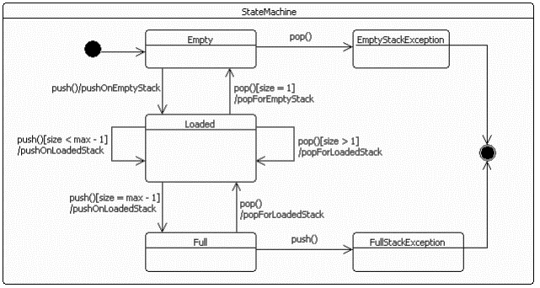

Introduction - Background
Test Evaluation
Test Oracle
A mechanism for determining whether a test has been passed or failed
Specified Test Oracles
UML, assertions, …
Implicit Test Oracles
Crash, error detection
Derived Test Oracles
Regression testing, Daikon
Notes:
Test evaluation 就是有了test case之後要怎麼evaluate測試的結果，要如何判斷哪些case有錯
Test oracle是一種用來判斷某項測試是否通過的機制
Regression testing: 用前一版本的測試結果來當作這次測試的oracle
Daikon
Invariant detector for C/C++, Java program, …, etc.
Invariant: e.g., x + y >=3

Slide 7
Introduction - Motivation
Derive test oracles of web applications
By exploiting their execution traces
Test automation bottleneck
Automated test oracles may not exist
Reduce the human effort
Enhance automation as much as possible
Black-box testing
Hard to know how dynamic web applications behave on the client-side
Construct a finite-state machine of the application with current version
Notes:
在這個流程中可以增強自動化越多越好
網頁的黑箱測試問題
現在大部分是動態網頁，沒辦法只看網頁原始碼就知道這個網頁會怎麼運作

Slide 8
Introduction - Purpose
Construct a model to evaluate traces
Pass and fail traces
Easy and efficient for the user
Combine testing & machine learning techniques
Use learning model & active learning to find a solution for test evaluation
Web user interface
Easy to manipulate and view the traces
No installations and settings

Slide 9
Outline
Introduction
Methodology
Test Oracle Learning System
Trace Collector
Learner
Experiment Results
Conclusion

Slide 10
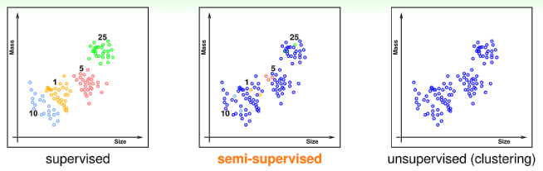
Methodology
Learning Problem
Types of Learning
Labels
Training data
Feature vectors
Learning algorithm
Testing data
Feature vectors
Predictive model
Expected labels

Slide 11
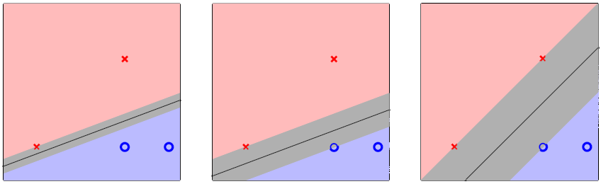
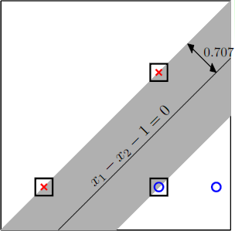
Methodology
Support Vector Machine (SVM)
Large-margin separating hyper-plane
Learn fattest hyper-planes with the help of support vectors
Source: Learning from Data, by Yaser Abu-Mostafa, Malik Magdon-Ismail and Hsuan-Tien Lin

Slide 12
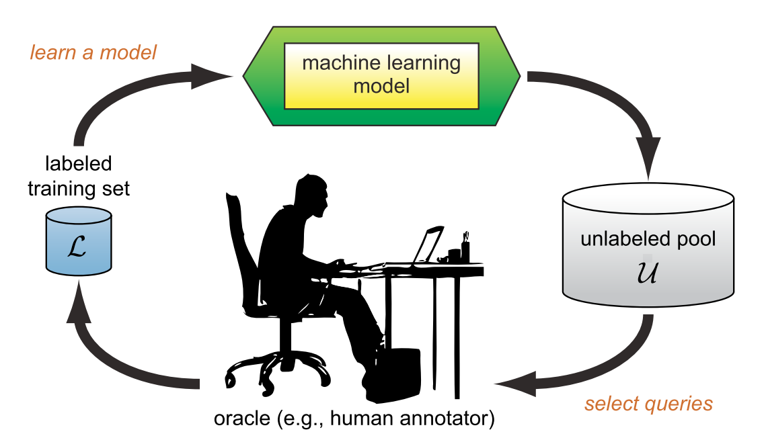
Methodology
Active Learning
Improve hypothesis with fewer labels by asking questions strategically
Situation
Labeling data is expensive
Large amounts of unlabeled data are available at low cost
Pool-Based Active Learning
Select the informative instances from a large pool of data
Source: Settles, B. (2010). Active Learning Literature Survey.
Notes:
Active learning就是讓機器主動去挑一些比較有用的data來給user做label

Slide 13
Outline
Introduction
Methodology
Test Oracle Learning System
Trace Collector
Learner
Experiment Results
Conclusion

Slide 14
System Overview
Learn how to evaluate the traces of the web application
One failed trace → other similar failed traces
Crawler
Feature Extraction
Sampling
SVM
Website
URL
Model
User Labeling
Trace Collector
Learner
Notes:
If a trace is labeled with fail label, the model can find similar fail traces.

Slide 15
Trace Collector
Crawler
Feature Extraction
Purpose
Collect traces automatically
Generate feature vectors
Crawler
Based on Crawljax library
Traverse the website and record its action to traces
Construct FSM
Feature Extraction
Construct feature vectors from the traces
Website
URL
Feature Vectors
Trace Collector

Slide 16
Feature Extraction
State-feature set
State, edge ID
Trace length
Keyword-feature set
Keyword count
Trace length
Action count
Has cycle(s)
Has cycle(s)
Action count
State, edge ID
Whether the trace pass through this state or edge.
Keyword/Action count
The number of times the keyword/action appears in the trace
Notes:
為甚麼要挑這些feature: 在ML領域裡本來就要盡量把data的statistics列出來，然後用learning找出哪些feature比較effective
同個keyword/action的出現次數

Slide 17
Outline
Introduction
Methodology
Test Oracle Learning System
Trace Collector
Learner
Experiment Results
Conclusion

Slide 18
Learner
Active Learning Procedure
Add thresholds to terminate
Sampling
Predict
Sampling
Predict Labels
Feature Vectors
Preprocessing
SVM
Feature Vectors
trace
Model
model
User Labeling
User Labeling
Train
Model
label
Learner
Learner
SVM

Slide 19
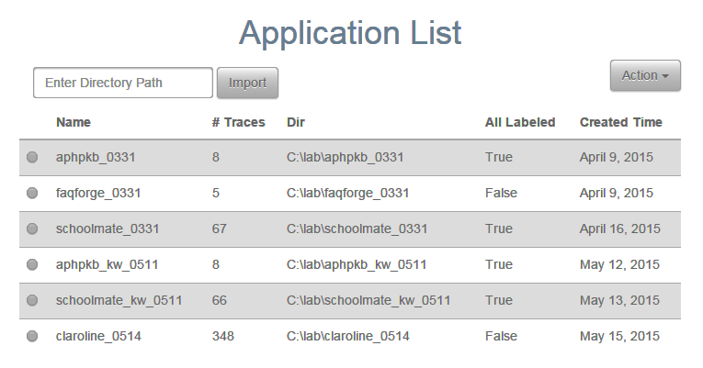
Learner
User Interface
Help user label the unlabeled trace

Slide 20
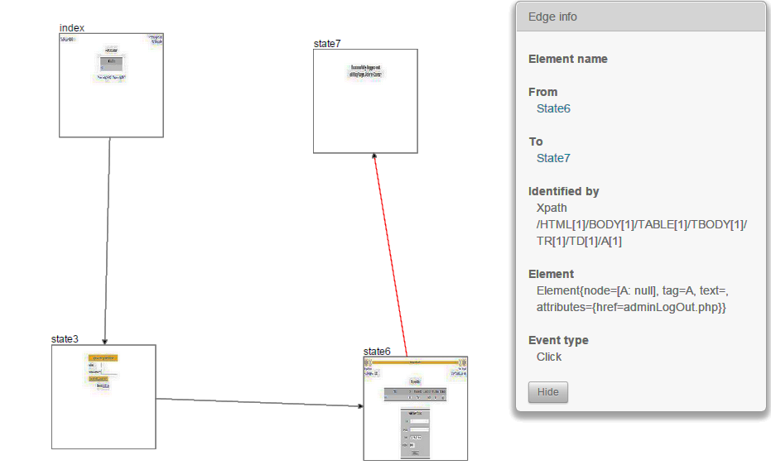
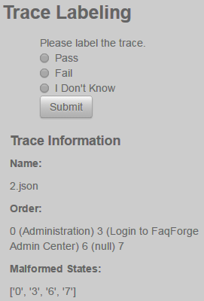
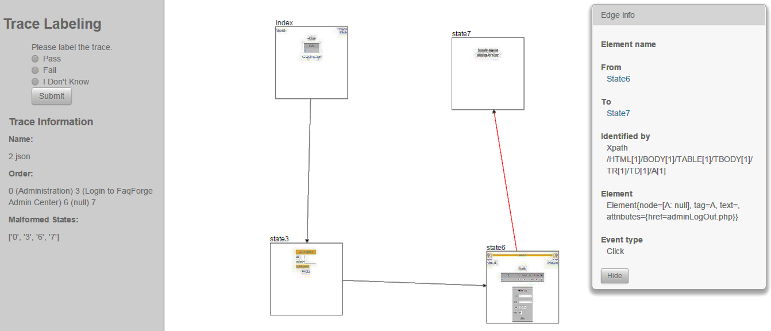
UI for Labeling Traces

Slide 21
Sampling Strategies
Greedy Sampling
Greedily select the trace which improves transition coverage the most with current model
Base on the FSM generated by crawler
0
0 → 1 → 2
3
0 → 1 → 2 → 4 → 5
1
0 → 1 → 4 → 5
4
0 → 3 → 4 → 5
2
0 → 3 → 5
5

Slide 22
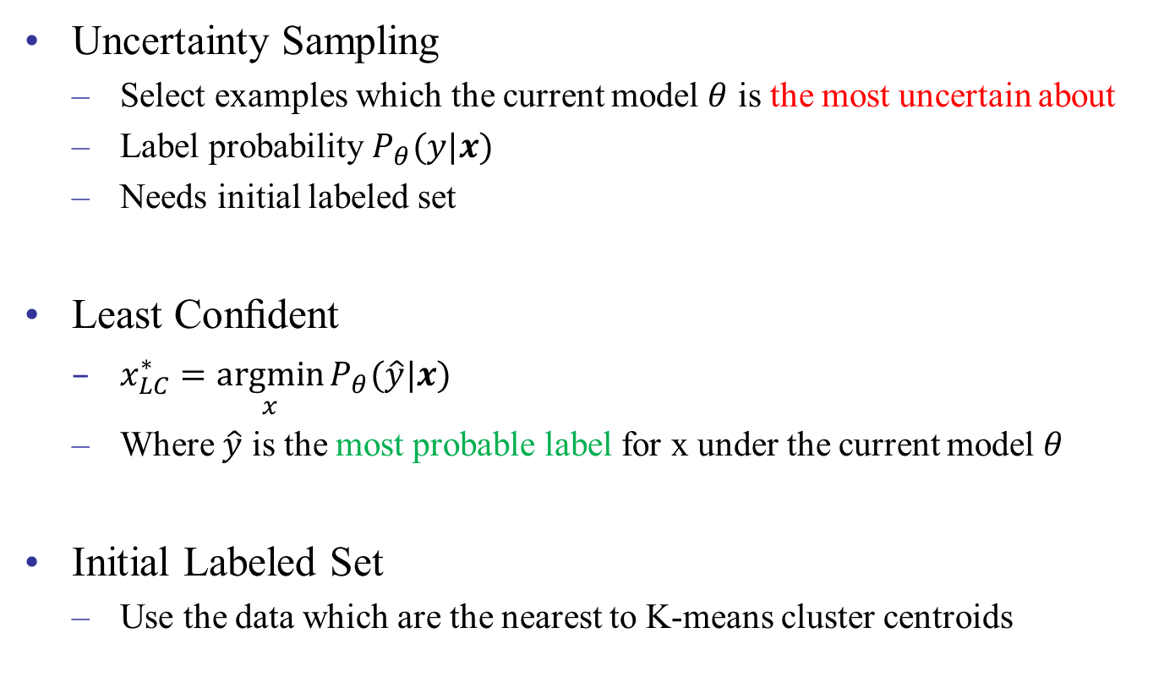
Sampling Strategies
Uncertainty Sampling
Select examples which the current model $θ$ is the most uncertain about
Label probability $P_{θ}(y|x)$
Needs initial labeled set
Least Conﬁdent
$x_{LC}^{∗}=\underset{x}{argmin}{P_{θ}(\hat{y}|x) }$
Where $\hat{y}$ is the most probable label for x under the current model $θ$
Initial Labeled Set
Use the data which are the nearest to K-means cluster centroids
Notes:
挑出這個model他最不確定label是甚麼的trace
找出最有可能label機率最小的x

Slide 23
Outline
Introduction
Methodology
Test Oracle Learning System
Trace Collector
Learner
Experiment Results
Conclusion

Slide 24
Experiment Results
RQ1: What is the proportion of traces should be labeled to get high enough accuracy?
RQ2: Which sampling strategy is better for our data?
RQ3: What is the difference between the two feature sets? And the compatibility with sampling strategies?

Slide 25
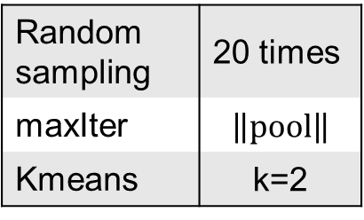
Experiment Results
Software Under Test (SUT)
aphpkb – online wiki
schoolmate – course management system
claroline – E-learning system
Random sampling | 20 times
maxIter | $$\left\|pool\right\|$$
Kmeans | k=2
program | # of trace |  |  | negative labels proportion | # of features
 |  |  |  |  | state-feature | keyword-feature
 | total | pass | fail
aphpkb | 83 | 51 | 32 | 38.55% | 222 | 165
schoolmate | 67 | 59 | 8 | 11.94% | 204 | 227
claroline | 348 | 319 | 29 | 8.33% | 1865 | 1005
Notes:
三個app都是之前別人的研究有用過，本身就有一些bug在裏頭

Slide 26
State-Feature Set
94%
98.5%
21
9
94.8%
98.3%
12
73
Notes:
xy軸
Aphpkb的greedy跑不好是因為edge數量太多 而state數量並不高 沒辦法穩定的挑到fail trace
claroline的LC也是沒辦法穩定挑到fail trace，initial set剛開始就挑到一條

Slide 27
Keyword-Feature Set
94%
96.97%
93.94%
24
7
26
95.98%
23
Notes:
Aphpkb的greedy本來就跑不好 LC不好是因為keyword太少比較不好判斷
Claroline的LC較好是因為有error, fail等keyword

Slide 28
Discussion - aphpkb
Notes:
Random的keyword比較好是因為failed的trace會沒有一些keyword
被問在講:LC的話可以看到兩個curve位移之後長得很像，應該是因為initial set的原因

Slide 29
Discussion - schoolmate

Slide 30
Discussion - claroline
Notes:
一般狀況下keyword的結果比較差，尤其對greedy而言
LC: keyword比state好是因為這個app出問題的時候會顯示error, fail的word

Slide 31
Outline
Introduction
Methodology
Test Oracle Learning System
Trace Collector
Learner
Experiment Results
Conclusion

Slide 32
Conclusion
Users only need to label 3 ~ 30% traces to get high accuracy
State-feature set
Easy to find abnormal states and actions
Need state abstraction for newly collected traces
Keyword-feature set
Easy to extend to new versions of the program
Uncertainty sampling is better with keyword-feature
Efficiency & Usability

Slide 33
Future Work
Different learning models
Deep learning, Decision tree, …
Batch-mode active learning
Efficiency
Parallel labeling
Other sampling strategies
Android applications

Slide 34

Q&A Thanks for your attention

Slide 35
References
[1] Andy’s PHP Knowledgebase Project. http://aphpkb.org/.
[2] Apache JMeter. http://jmeter.apache.org/.
[3] Crawljax: crawling ajax-based web applications. http://crawljax.com/.
[4] SchoolMate: PHP/MySQL solution for elementary, middle and high schools. http://sourceforge.net/projects/schoolmate/.
[5] Selenium: web browser automation. http://www.seleniumhq.org/.
[6] The W3C Markup Validation Service. https://validator.w3.org/.
[7] S. Artzi, A. Kiezun, J. Dolby, F. Tip, D. Dig, A. Paradkar, and M. D. Ernst. Finding bugs in dynamic web applications. Proceedings of the 2008 international symposium on Software testing and analysis ISSTA 08, page 261, 2008.
[8] E. T. Barr, M. Harman, P. Mcminn, M. Shahbaz, and S. Yoo. The Oracle Problem in Software Testing : A Survey. IEEE Transactions on Software Engineering, 41(5):507 – 525, 2015.
[9] M. Benedikt, J. Freire, and P. Godefroid. VeriWeb: Automatically testing dynamic web sites. 11th Int. Conf. on World Wide Web (WWW02), 2002.
[10] C.-c. Chang and C.-j. Lin. LIBSVM : A Library for Support Vector Machines. ACM Transactions on Intelligent Systems and Technology (TIST), 2:1–39, 2011.
[11] C. Cortes and V. Vapnik. Support-Vector Networks. Machine Learning, 20(3):273–297, 1995.
[12] M. D. Ernst, J. Cockrell, W. G. Griswold, D. Notkin, and I. C. Society. Dynamically Discovering Likely Program Invariants to Support Program Evolution. IEEE Transactions on Software Engineering, 27(2):99–123, 2001.

Slide 36
References
[13] S. C. H. Hoi, R. Jin, J. Zhu, and M. R. Lyu. Batch mode active learning and its application to medical image classiﬁcation. Proceedings of the 23rd International Conference on Machine learning - ICML ’06, pages 417–424, 2006.
[14] U. Kanewala and J. M. Bieman. Using machine learning techniques to detect metamorphic relations for programs without test oracles. 2013 IEEE 24th International Symposium on Software Reliability Engineering, ISSRE 2013, pages 1–10, 2013.
[15] J. Kang, K. R. Ryu, and H.-C. Kwon. Using cluster-based sampling to select initial training set for active learning in text classiﬁcation. Advances in knowledge discovery and data mining, pages 384–388, 2004.
[16] a. Marchetto, a. Marchetto, P. Tonella, P. Tonella, F. Kessler-IRST, and F. Kessler-IRST. Search-Based Testing of Ajax Web Applications. Doi.Ieeecomputersociety.Org, 2009.
[17] A. Mesbah, A. Van Deursen, and D. Roest. Invariant-based automatic testing of modern web applications. IEEE Transactions on Software Engineering, 38(1):35–53, 2012.
[18] M. Mirzaaghaei and A. Mesbah. DOM-Based Test Adequacy Criteria for Web Applications. Issta, pages 71–81, 2014.
[19] F. Ricca and P. Tonella. Analysis and testing of Web applications. Proceedings of the 23rd International Conference on Software Engineering ICSE 2001, 47(6):25–34, 2001.
[20] B. Settles. Active Learning Literature Survey. Machine Learning, 15(2):201–221, 2010.
[21] Y. Zou, Z. Chen, Y. Zheng, X. Zhang, and Z. Gao. Virtual DOM Coverage : Drive an Effective Testing for Dynamic Web Applications Categories and Subject Descriptors. Proceedings of the 2014 international symposium on Software testing and analysis ISSTA 14, pages 60–70, 2014.

Slide 37
Appendix
Input:
U, L, maxIter, leastConf
Preprocessing(U)
i = 1
i ≤ maxIter
N
Y
trace ← Sampling( L, U )
label ← getUserLabel(trace)
Update( L, U, trace, label )
M ← SVMTrain(L)
acc, labels_{predict}, prob ← SVMPredict( L, U, M )
Output:
M, acc, labels_{predict}
i = i + 1
N
min(prob) ≥ leastConf
Y

Slide 38
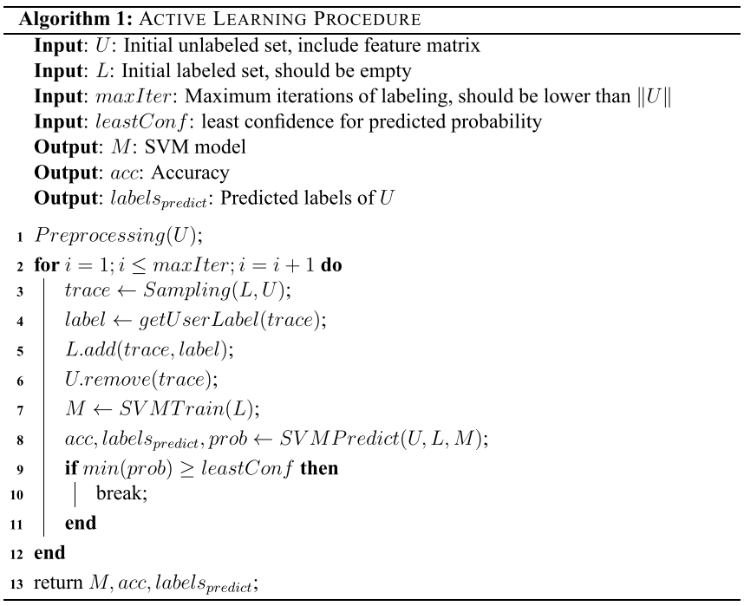
Appendix

Slide 39
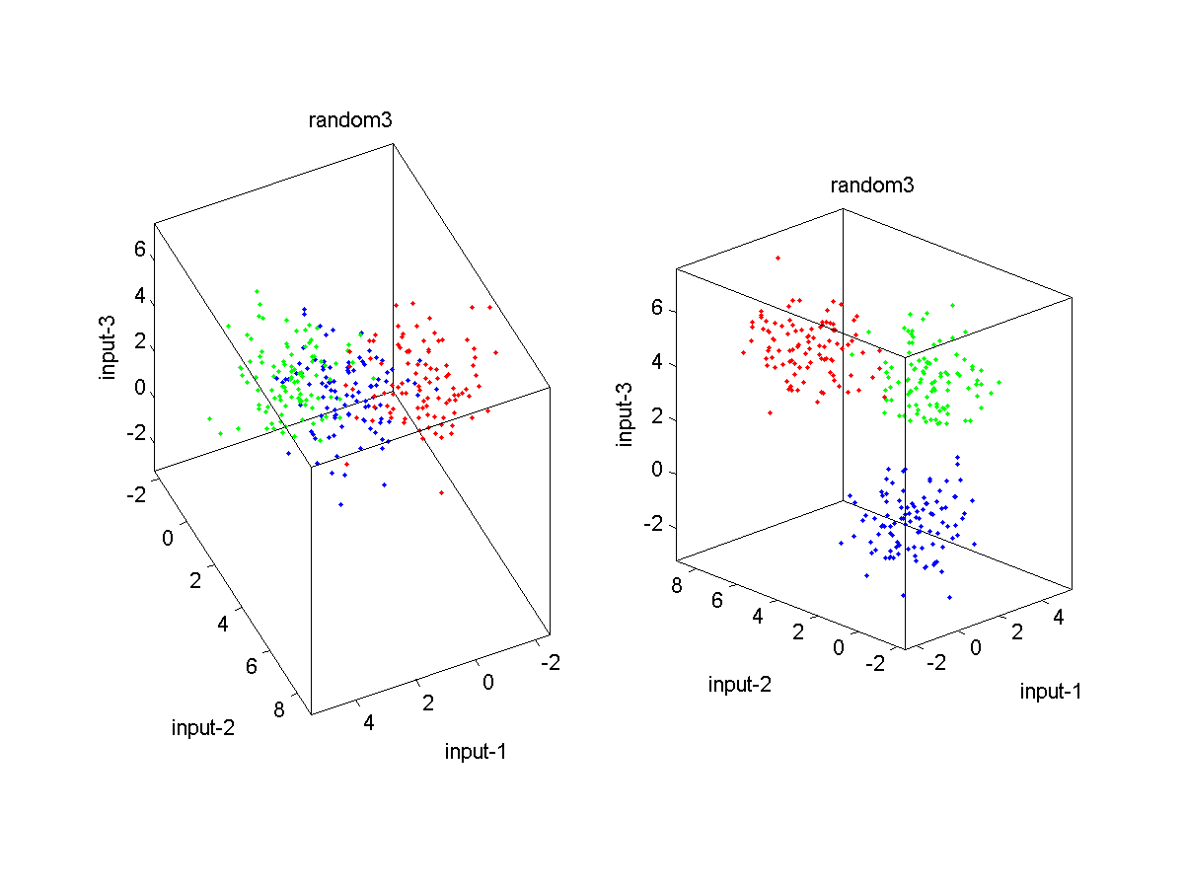
Appendix
Principal Component Analysis(PCA)
An effective method for reducing dataset dimensions while keeping spatial characteristics
Characteristics
For unlabeled data
A linear transform with solid mathematical foundation

Slide 40
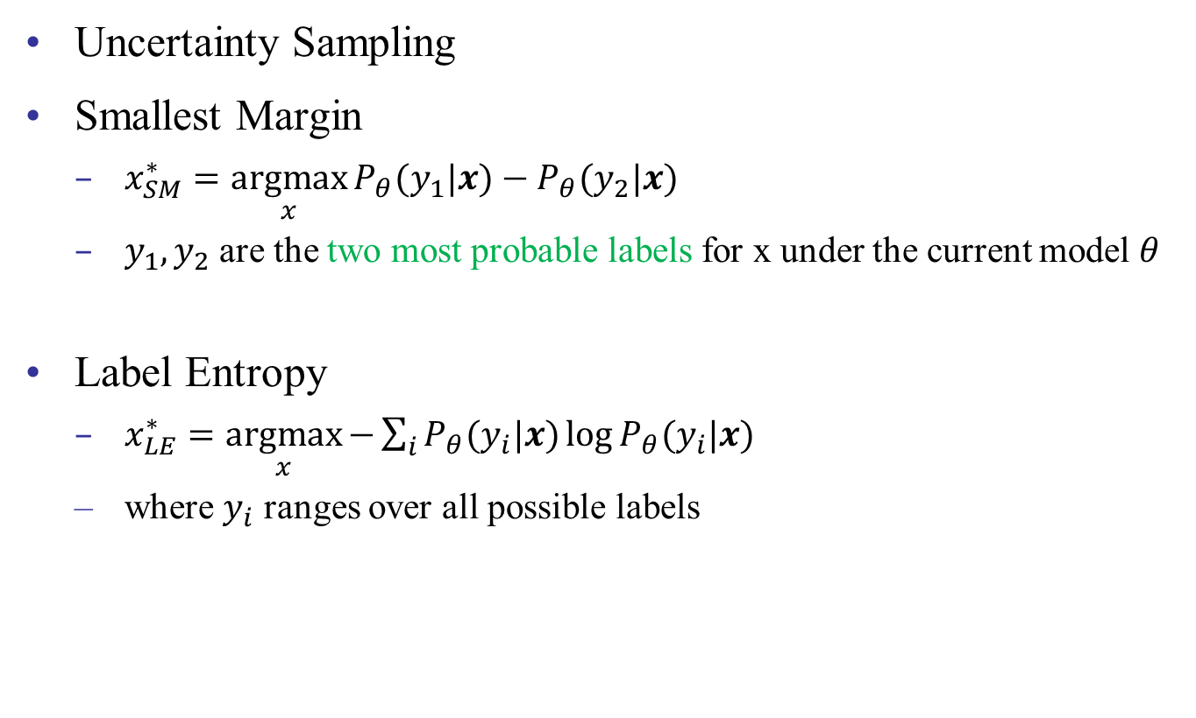
Appendix
Uncertainty Sampling
Smallest Margin
$x_{SM}^{∗}=\underset{x}{argmax}{P_{θ}(y_{1}|x)−P_{θ}(y_{2}|x) }$
$y_{1}, y_{2}$ are the two most probable labels for x under the current model $θ$
Label Entropy
$x_{LE}^{∗}=\underset{x}{argmax}{−\sum_{i}{P_{θ}(y_{i}|x)\log{P_{θ}(y_{i}|x)}}}$
where $y_{i}$ ranges over all possible labels

